Slide 1

SEHH2240 Database systems CC Food DELIVERY PLATFORM
Prepared by Class 201 Group B4
20077067A CHO Shing Yin
20065935A KWOK Chun Wing
20193240A WONG Cho Hin
20053334A WONG Tin Yau

Slide 2
Content
1. Introduction
2. Business rules
3. Conceptual model (ERD)
4. Logic design
a) Tables
b) Queries
c) Applications
5. Physical design
Software used
Source of data
6. Implementation detail
a) Flow charts of the program
b) Sample results with explanations
7. Difficulties
a) Design
b) Implementation
c) Lesson learnt
8. Conclusion

Slide 3
INTRODUCTION
Aims
- storing different data that will be used during food delivery.
By searching the database system:
- For client:
They can choose and order food from our platform.
- For our staff:
They can check the order from the platform.
- For business partner:
They can check how manty orders they have taken from our platform and check and check their turnover.

Slide 4
BUSINESS RULE - TABLE
Business
Client
Event
Food
Food Truck
Order
Admin
Admin Level
Order Food
Staff

Slide 5
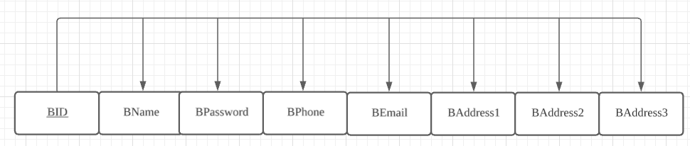
BUSINESS RULES-Business

Slide 6
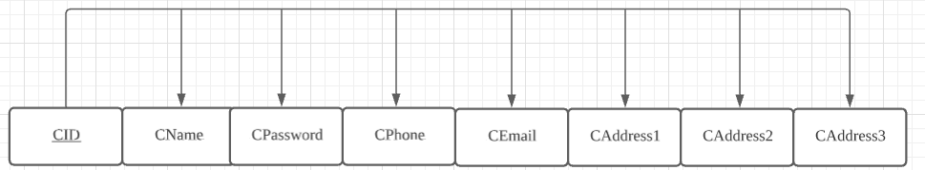
BUSINESS RULES-Client

Slide 7
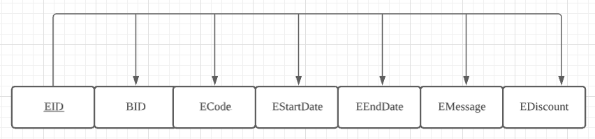
BUSINESS RULES - EVENT

Slide 8
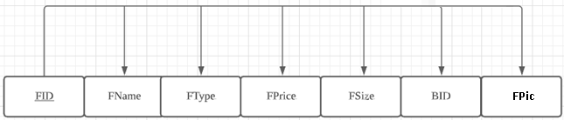
BUSINESS RULES - Food

Slide 9
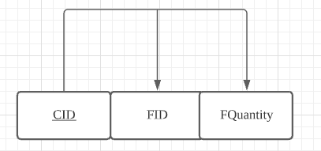
BUSINESS RULES – Food truck

Slide 10
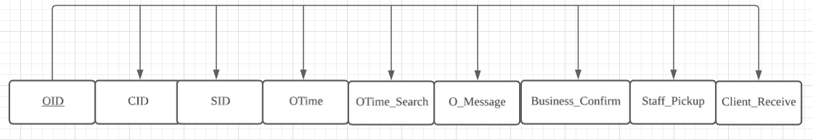
BUSINESS RULES - ORDER

Slide 11
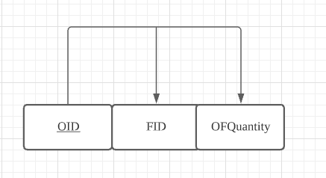
BUSINESS RULES – ORDER_Food

Slide 12
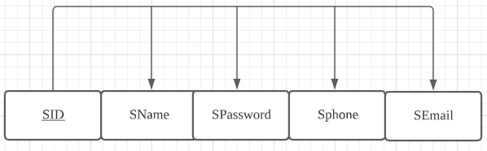
BUSINESS RULES - STAFF

Slide 13
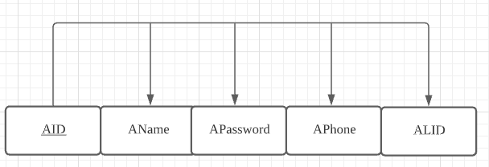
BUSINESS RULES - admin

Slide 14
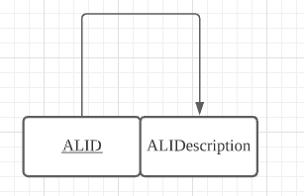
BUSINESS RULES - Adminlevel

Slide 15
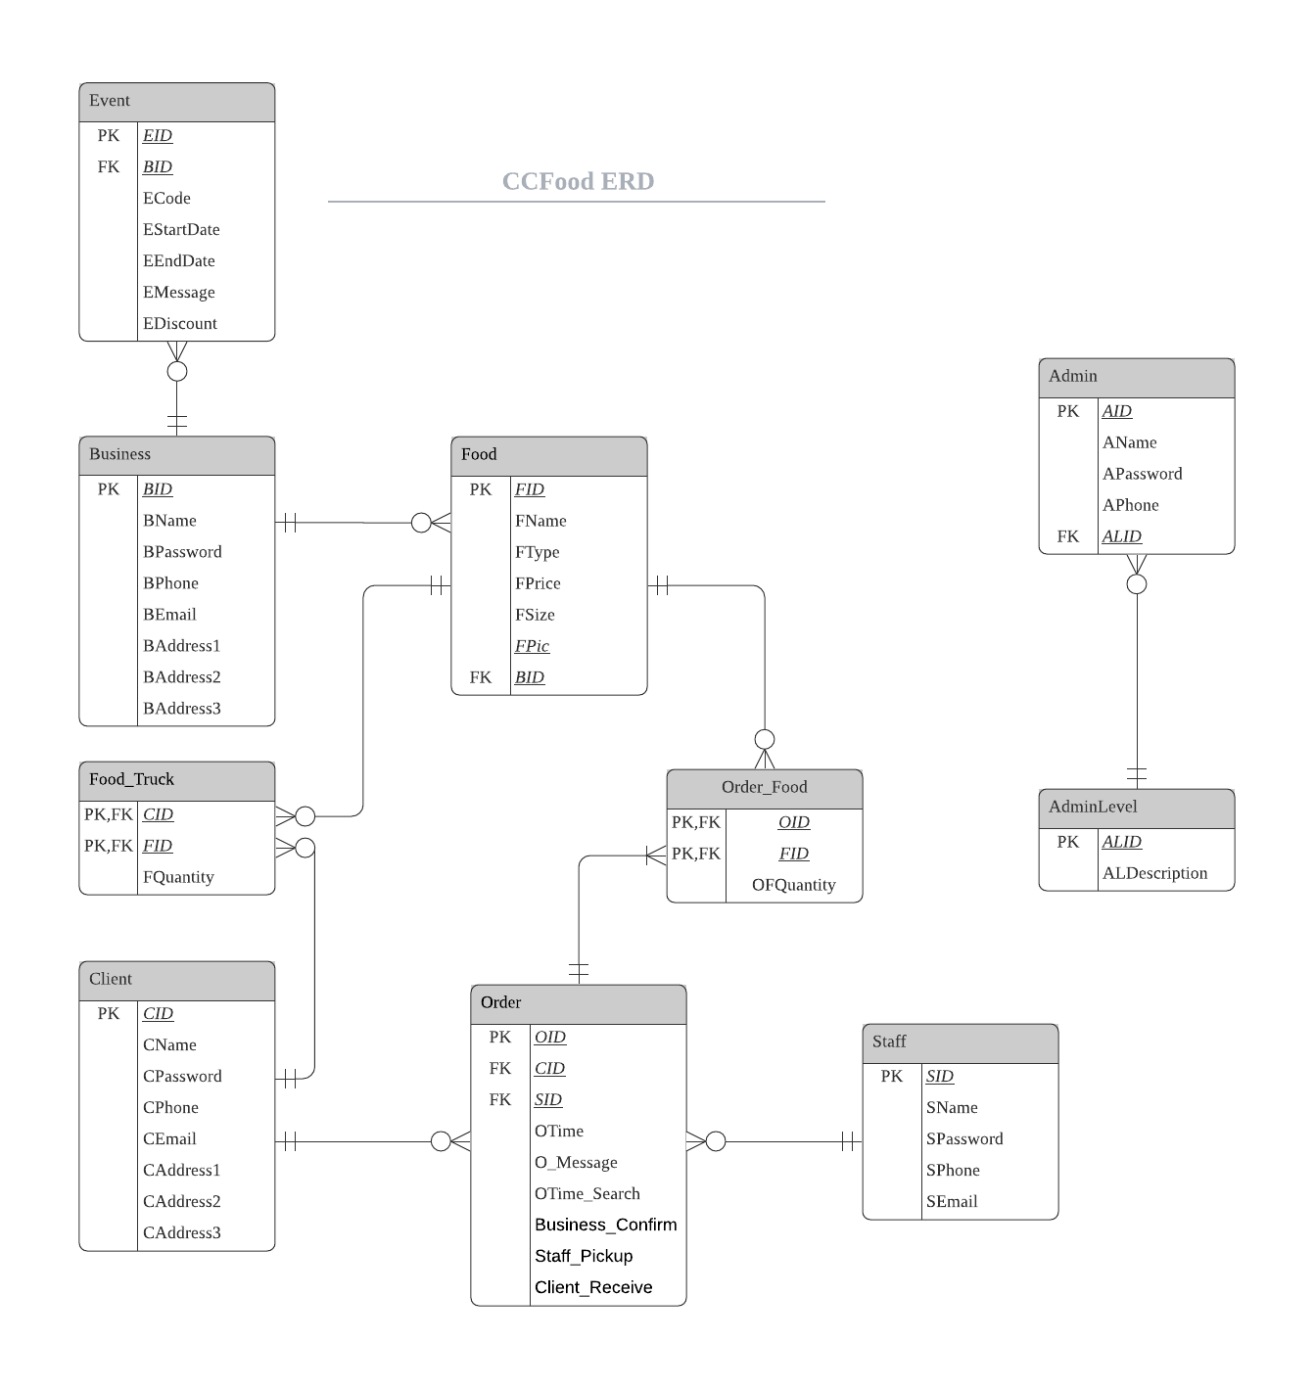
CONCEPTUAL MODEL(ERD)

Slide 16
LOGIC DESIGN - TABLE
Business
Client
Event
Food
Food Truck
Order
Admin
Admin Level
Order Food
Picture
Staff

Slide 17
LOGIC DESIGN - TABLE
Business
Client
Event
Food
Food Truck
Admin
Admin Level
Order Food
Staff
Order

Slide 18
Business
 | Attribute | Data Type | Description | Size | Rule
PK | BID | AutoNumber | Business ID
 | BName | Short Text | Business Name |  | Not Null
 | BPassword | Long Text | Business Password | 576 | Not Null
 | BPhone | Number | Business Phone | 8 | *
 | BEmail | Long Text | Business Email | 50
 | BAddress1 | Long Text | Business Address Area |  | Not Null
 | BAddress2 | Long Text | Business Address Street
 | BAddress3 | Long Text | Business Address Room
LOGIC DESIGN –
TABLE – Business

Slide 19
LOGIC DESIGN –
TABLE – Client
Client
 | Attribute | Data Type | Description | Size | Rule
PK | CID | AutoNumber | Client ID
 | CName | Short Text | Client Name |  | Not Null
 | CPassword | Long Text | Client Password | 576 | Not Null
 | CPhone | Number | Client Phone | 8 | *
 | CEmail | Long Text | Client Email | 50
 | CAddress1 | Long Text | Client Address Area
 | CAddress2 | Long Text | Client Address Street
 | CAddress3 | Long Text | Client Address Room

Slide 20
Event
 | Attribute | Data Type | Description | Size | Rule
PK | EID | AutoNumber | Event ID
FK | BID | AutoNumber | Business ID
 | ECode | Long Text | Event Code |  | Not Null
 | EStartDate | Number | Event Start Date
 | EEndDate | Long Text | Event End Date
 | EMessage | Long Text | Event Description
 | EDiscount | Long Text | Event Discount
LOGIC DESIGN –
TABLE – Event

Slide 21
Food
 | Attribute | Data Type | Description | Size | Rule
PK | FID | AutoNumber | Food ID
 | FName | Long Text | Food Name |  | Not Null
 | FType | Long Text | Food Type
 | FPrice | Number | Food Price
 | FSize | Long Text | Food Size
FK | BID | AutoNumber | Business ID
 | FPic | Attachment | Food Picture
LOGIC DESIGN –
TABLE – Food

Slide 22
LOGIC DESIGN –
TABLE – Food_Truck
Food_Truck
 | Attribute | Data Type | Description | Size | Rule
PK | CID | Number | Client ID
FK | FID | Number | Food ID
 | FQuantity | Number | Food Number

Slide 23
Order
 | Attribute | Data Type | Description | Size | Rule
PK | OID | AutoNumber | Order ID
FK | CID | Number | Client ID
FK | SID | Number | Staff ID
 | OTime | Date/Time | Order Time in hour
 | OTime_Search | Date/Time | Order Time in day
 | O_Message | Long Text | Order Message
 | Business_Confirm | Yes/No | Confirm finished making by Restaurant
 | Staff_Pickup | Yes/No | Confirm Picked up by Staff
 | Client_Receive | Yes/No | Confirm received by Client
LOGIC DESIGN –
TABLE – Order

Slide 24
LOGIC DESIGN –
TABLE – Order_Food
Order_Food
 | Attribute | Data Type | Description | Size
PK | OID | Number | Order ID
FK | FID | Number | Food ID
 | OFQuantity | Number | Quantity

Slide 25
LOGIC DESIGN –
TABLE – Staff
Staff
 | Attribute | Data Type | Description | Size | Rule
PK | SID | AutoNumber | Staff ID
 | SName | Short Text | Staff Name |  | Not Null
 | SPassword | Long Text | Staff Password | 576 | Not Null
 | SPhone | Number | Staff Phone number | 8 | *
 | SEmail | Long Text | Staff E-mail | 50

Slide 26
LOGIC DESIGN –
TABLE – Admin
Admin
 | Attribute | Data Type | Description | Size | Rule
PK | AID | AutoNumber | Admin ID
 | AName | Long Text | Admin Name |  | Not Null
 | APassword | Long Text | Admin Password | 576 | Not Null
 | APhone | Number | Admin Phone number | 8 | *
FK | ALID | AutoNumber | Admin Level ID |  | Not Null

Slide 27
LOGIC DESIGN –
TABLE – AdminLevel
AdminLevel
 | Attribute | Data Type | Description | Size | Rule
PK | AID | AutoNumber | Admin ID
 | AName | Long Text | Admin Name |  | Not Null

Slide 28
Demonstration TIME

Slide 29
CONCLUSION
During designing this database, we encountered many difficulties, such as the normalization, resolve M: N relationship. We put lots of effort and research to solve the problem. Finally, we use energy and persistence to conquer all things. We also learnt that building a small database also consume a lot of time. We need to think how to design tables and how to make a report or a query to present the data clearly.
While designing the database, we gain a better understanding of how a food delivery platform works. We need to care the needs of business partners, customers and our staffs. We have to think about their actual use when designing the UI , forms and queries.
All in all, we gained a lot while making this platform. Although there are still spaces for improvement, it is hoped that this food delivery platform can really provide convenience for users in daily life.

Slide 30

Thank YOU!

